Slide 1
Statistical Inference
Matched Pairs & Independent Means

Slide 2
Problem: Express Deliveries (from Anderson Sweeney and Williams).
Application: Hypothesis Test About the Difference Between the Means of Two Populations - Matched Samples
Problem Description: A Chicago based firm has managerial reports that must be distributed to district offices throughout the United States. Because of the critical information contained in the reports, quick deliveries to the district offices are essential. The firm has decided to select one of two delivery services that in the promise next-day deliveries to the district offices. In testing the delivery times for the two services, the firm sends two reports to each of 10 district offices with one report carried by one delivery service and the other carried by the second delivery service. Do the data shown below indicate a difference in mean delivery times for the services? Note: Delivery times reported in hours.

Slide 3
District Overnight Flight
Office Courier Express
Seattle 32 25
LA 30 24
Boston 19 15
Cleveland 16 15
New York 15 13
Houston 18 15
Atlanta 14 15
St. Louis 10 8
Milwaukee 7 9
Denver 16 11
Matched Sample: One random sample of ten district offices was selected with delivery times to each sampled office recorded for the delivery service. Each district office provided a pair of data values.

Slide 4
District Overnight Flight
Office Courier Express Differences
Seattle 32 25 +7
LA 30 24 +6
Boston 19 15 +4
Cleveland 16 15 +1
New York 15 13 +2
Houston 18 15 +3
Atlanta 14 15 −1
St. Louis 10 8 +2
Milwaukee 7 9 −2
Denver 16 11 +5
Notationally represent these differences by d_{i}

Slide 5
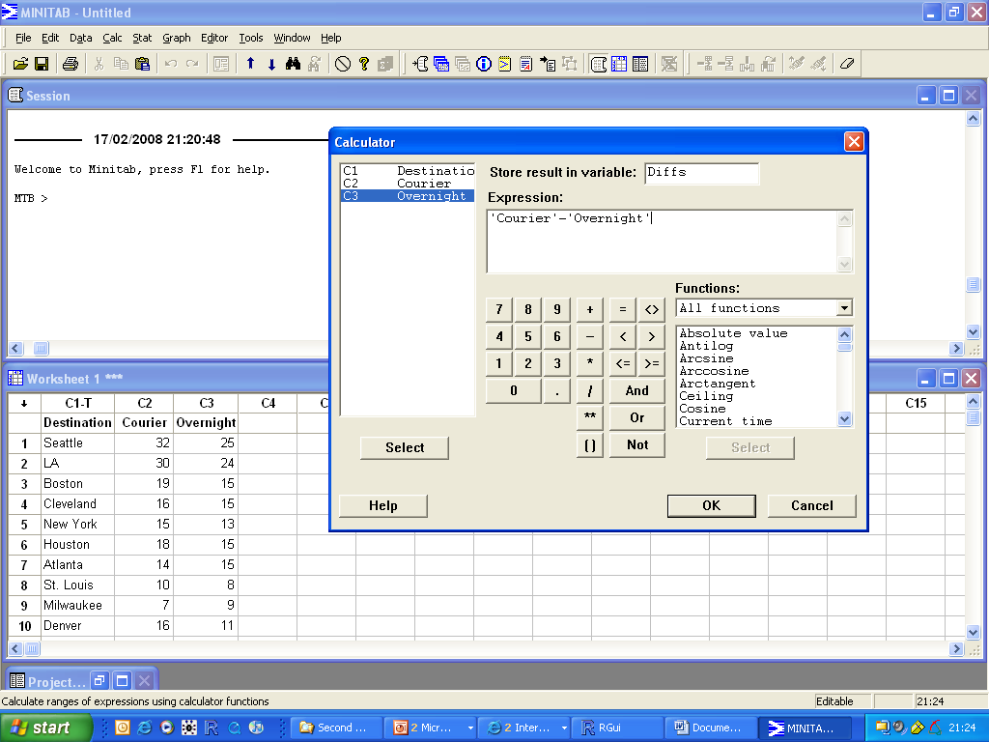

Slide 6
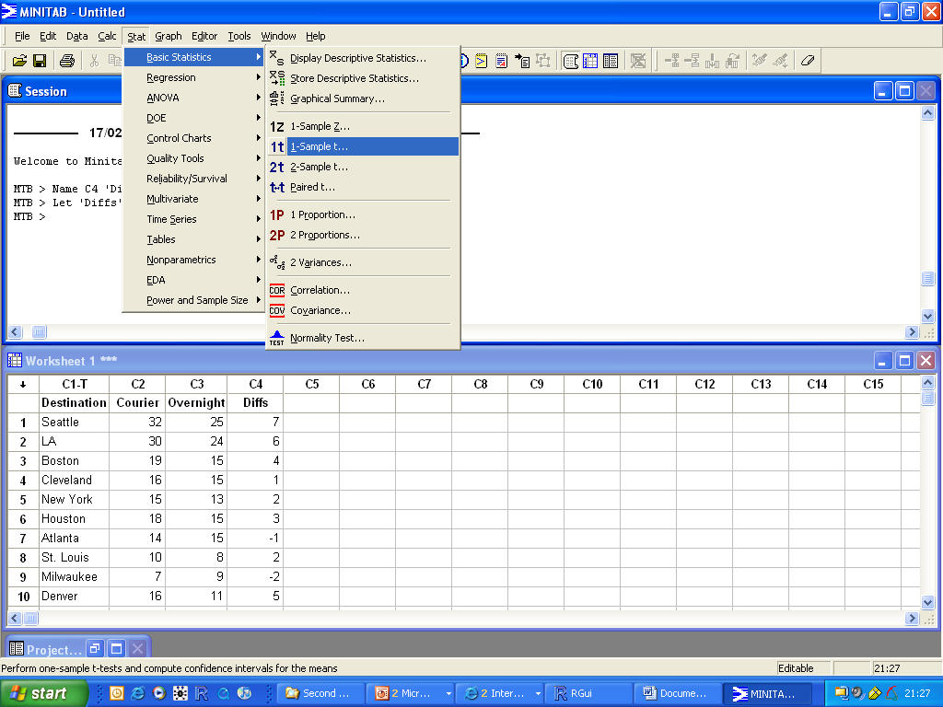

Slide 7
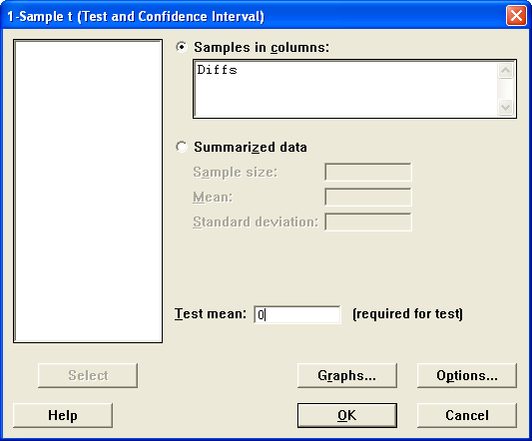
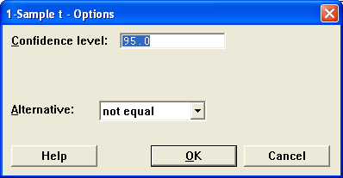

Slide 8
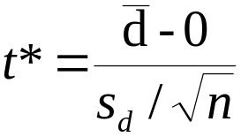
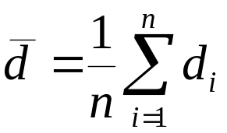

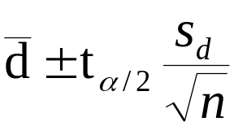
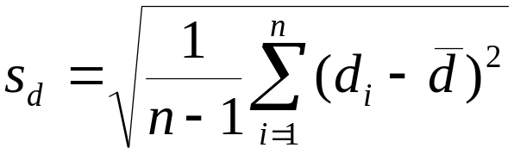
One-Sample T: Diffs
Test of mu = 0 vs not = 0
Variable N Mean StDev SE Mean 95% CI T P
Diffs 10 2.70000 2.90784 0.91954 (0.61985, 4.78015) 2.94 0.017
MTB >
Correspond p-value for the observed value of t*

Slide 9
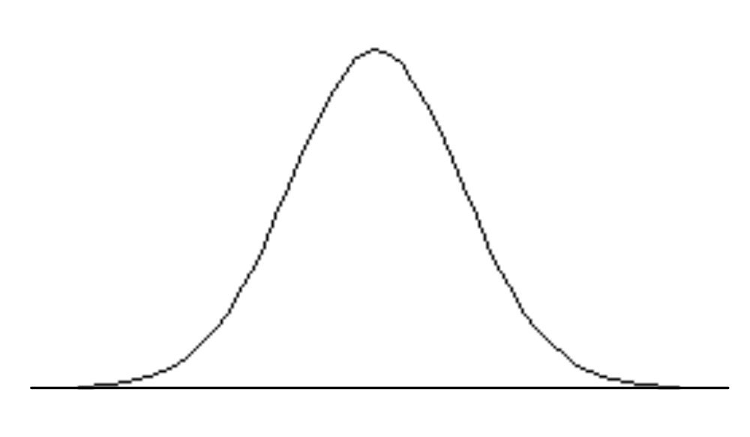
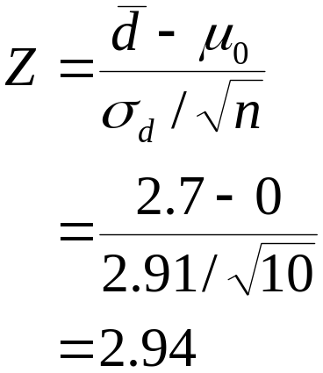
Let μ_{d} = mean of the difference values for the two delivery services for the population of district offices.
Hypotheses Conclusion and Action
Ho: μ_{d} = 0 No difference in the mean delivery times for the two services; no action necessary.
Ha: μ_{d} ≠ 0 A difference exists in the mean delivery times; select
the service with the smaller mean delivery time.
-2.262
2.262

Slide 10
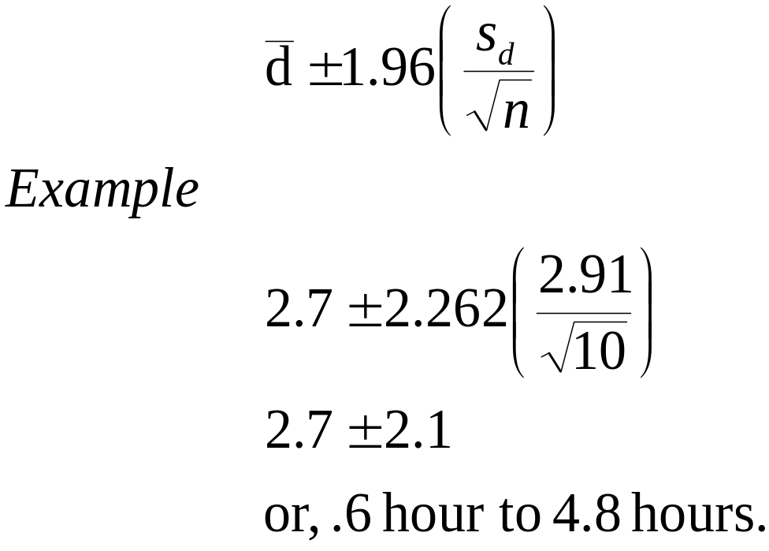

Slide 11
before = c(32, 30, 19, 16, 15, 18, 14, 10, 7, 16)
after = c(25, 24, 15, 15, 13, 15, 15, 8, 9, 11)
t.test(before, after, paired = TRUE)
qqnorm(before-after)

Slide 12
Problem Description: Par, Incorporated is a manufacturer of golf equipment. Recently Par has developed a new golf ball that has been designed to provide “extra distance”. In a test of driving distance, a sample of Par golf balls was compared with a sample of golf balls made by Par’s competitor. A mechanical driving device was used to create a constant driving force and the distance that each sample ball travelled was recorded. Estimate any difference arising.
Sample Data:
Par, Inc Competitor
Sample Size 120 balls 80 balls
Mean 235 yards 218 yards
Standard Deviation 15 yards 20 yards

Slide 13

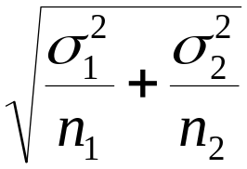
Let
μ₁ = mean distance for the population of Par golf balls.
μ₂ = mean distance for the population of the competitor’s golf balls.
Problem: Using the data for the two samples, develop a 95% confidence interval estimate for the difference between the two population means; that is, μ₁ - μ₂. The best point estimate of μ₁ - μ₂
is , but what is its sampling distribution?
μ₁ - μ₂

Slide 14
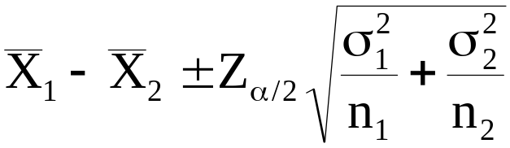
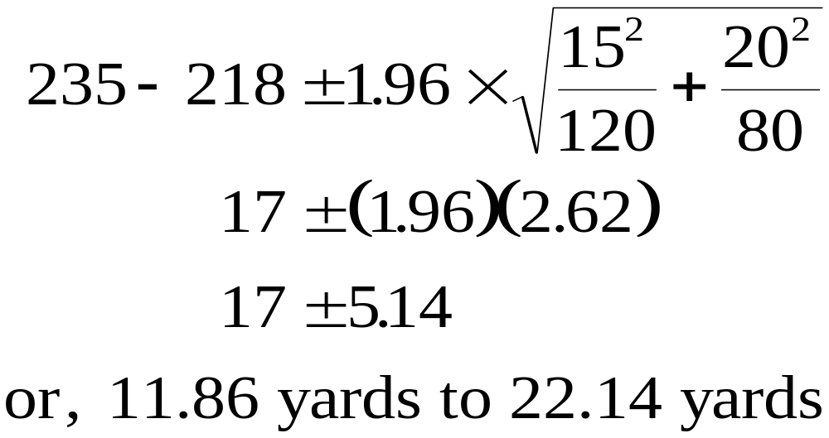
Interval Estimate of the Difference Between the Means of Two Populations: Large Sample Case
Note: If the two population standard deviations are unknown, the sample standard deviations s₁ and s₂ can be substituted for the population standard deviation σ₁ and σ₂. A 95% CI for our data:

Slide 15
Mullins (2004): Pendl et al. describe a fast, easy and reliable quantitative method (GC) for determining the total fat in food & animal feeds. The summary statistics shown represent the results (% fat) of replicate measurements on margarine by laboratories A and B.
A B
  Sample Size 12 8
  Mean 29.8 27.3
  Standard Deviation 2.56 1.81
Note: with n₁ =12 and n₂ = 8, we are unable to use the large-sample procedure to develop an interval estimate of the difference between the means of the two populations

Slide 16
As a result, we will conduct the statistical analysis for the GC example based on statistical methodology available for developing interval estimates of the difference between the means of two normally distributed populations with equal variances.
Small Sample Case: n₁ < 30 and/or n₂ < 30
Assumptions for the Small-Sample Case:
1. The measurements of % fat recovered must be normally distributed for both laboratories.
2. The variance in the % fat recovered must be the same for both laboratories.

Slide 17
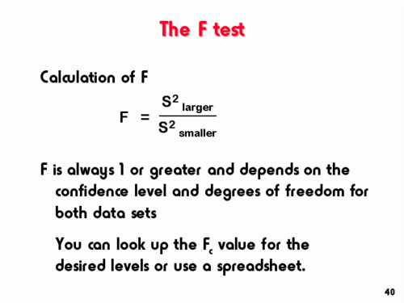
We consider assumption 2 first…

Slide 18
The F-ratio: These is needed to test the assumption that the variances of the two populations are equal. We are testing the hypotheses
        Ho: σ²_{A} = σ²_{B}
        Ha: σ²_{A} ≠ σ²_{B}
        F* = (2.56)² / (1.81) ²
        = 2.000
11 df in the
numerator
7 df in the
demoninator

Slide 19
F-Ratio Rejection Rule
F ratio with α = .05 on 11 (numerator) and 7 (denominator) degrees of freedom
Area = 2.5%
Do Not Reject H₀
Reject H₀
4.71
F* = 2.00

Slide 20
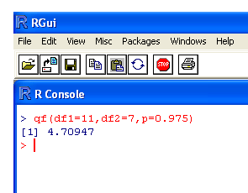
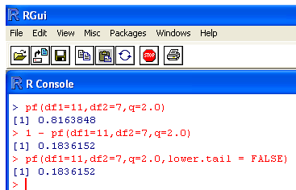
Looking up the cut off value from an F distribution on 11df and 7df is straightforward in R
Looking up the p-value for the calculated test statistic F* = 2.0 from an F distribution on 11df and 7df is straightforward in R

Slide 21

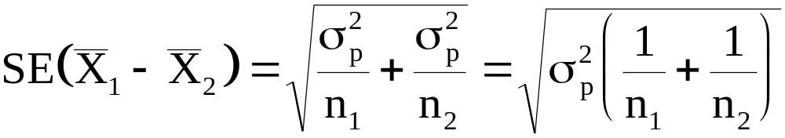
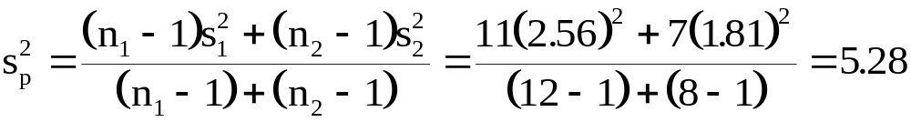
Under assumption 2, we have
Thus
The estimate of σ² is based on a combining or pooling of the results of both samples to obtain one estimate of σ².
Pooled Estimate of σ²

Slide 22
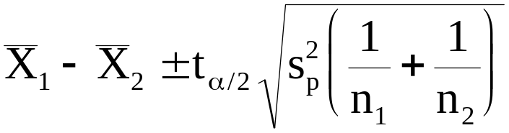
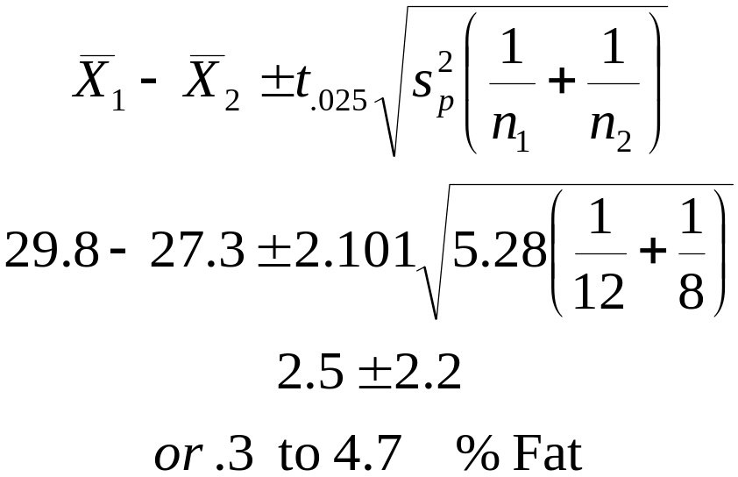
Interval Estimate of the Difference Between
the Means of Two Populations: Small Sample Case
Normal Populations with Equal Variances Estimated by s²
Note: that the t value is based on a t distribution with (n₁+n₂-2) df.

Slide 23
The miles per gallon efficient of 28 U.S. manufactured and 13 Japanese manufactured cars were determined.
To read the data into R use the commands:
JAPmpg = c(24 , 27 , 27 , 25 , 31 , 35 , 24 , 19 , 28 , 23 , 27 , 20 , 22 )
USmpg = c(18 , 15 , 18 , 16 , 17 , 15 , 14 , 14 , 14 , 15 , 15 , 14 , 15 ,
14 , 22 , 18 , 21 , 21 , 10 , 10 , 11 , 9 , 28 , 25 , 19 , 16 , 17 , 19 )
To calculate the standard deviations of each group, use the commands:
sd(JAPmpg)
sd(USmpg)
To calculate carry out the F test, use the command:
var.test( JAPmpg , USmpg )

Slide 24
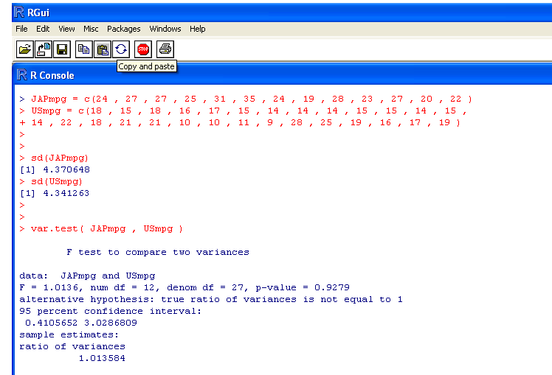

Slide 25
